Slide 1
AI Basics

Slide 2
What is Artificial Intelligence
Artificial Intelligence (AI) is the simulation of human intelligence processes by computer systems and machines. These systems learn from data, recognize patterns, reason, and make decisions to solve complex problems.
Definition: AI is an umbrella term for technology that allows machines to perform tasks typically requiring human cognitive functions—such as speech recognition, visual interpretation, and problem-solving.

Slide 3
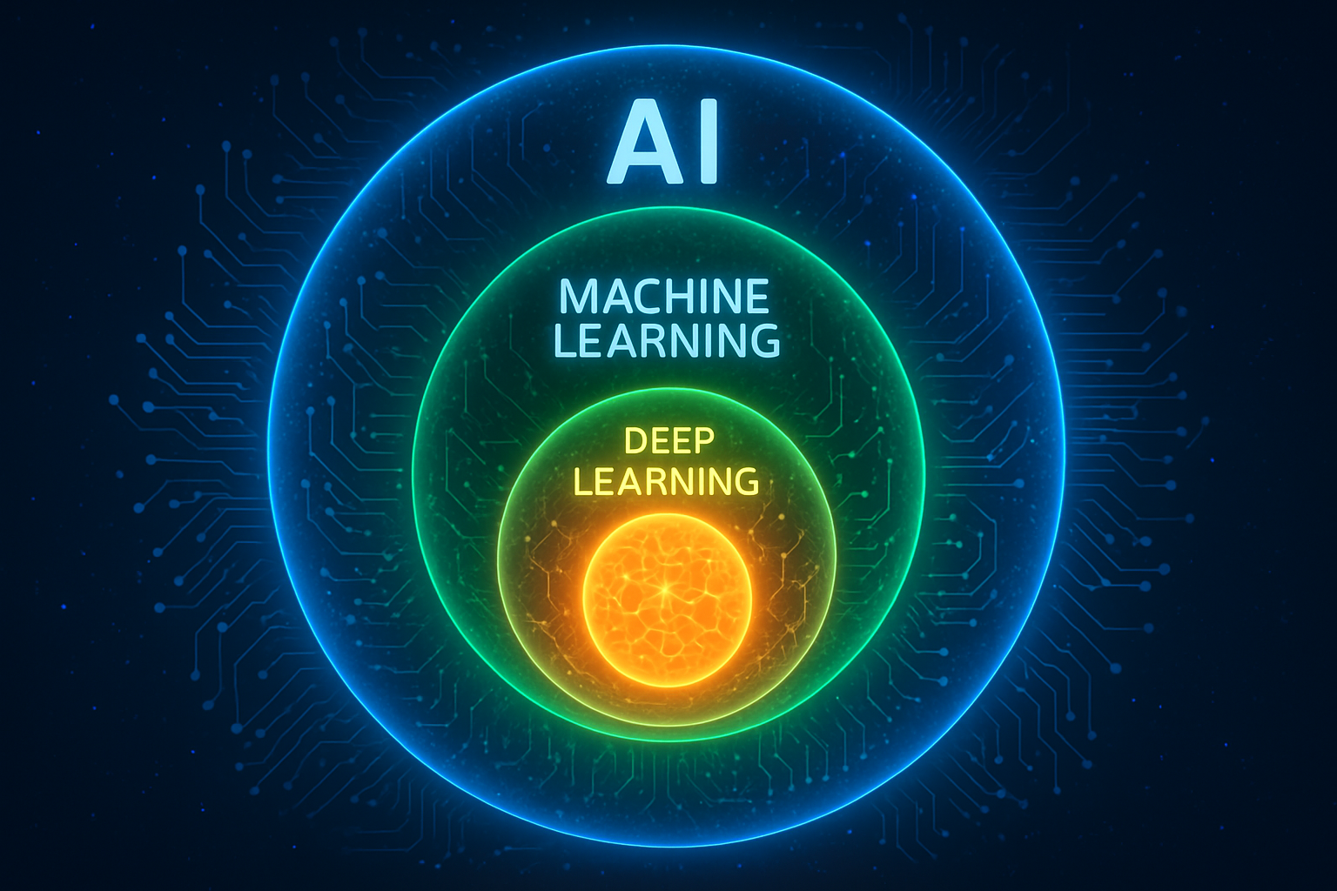
Subsets of AI
Artificial Intelligence (AI), Machine Learning (ML), and Deep Learning (DL) form a nested hierarchy where each concept is a specialized subset of the one before it: AI is the largest umbrella, ML is a subset of AI, and Deep Learning is a subset of ML.

Slide 4
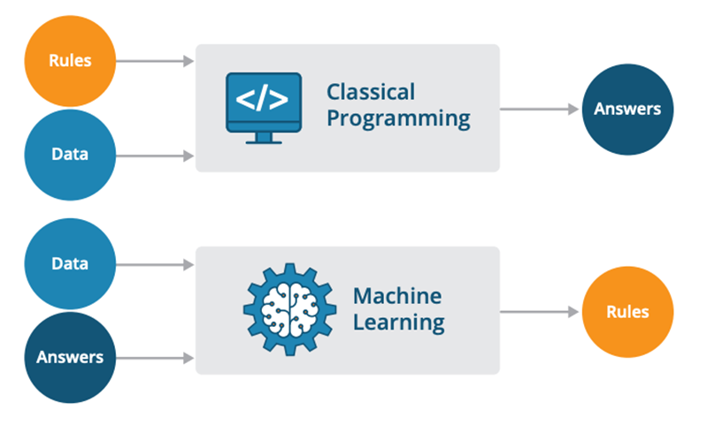
Machine Learning
Machine Learning is a discipline in computer science where we train machines on data so that they can make predictions without explicit programming.

Slide 5
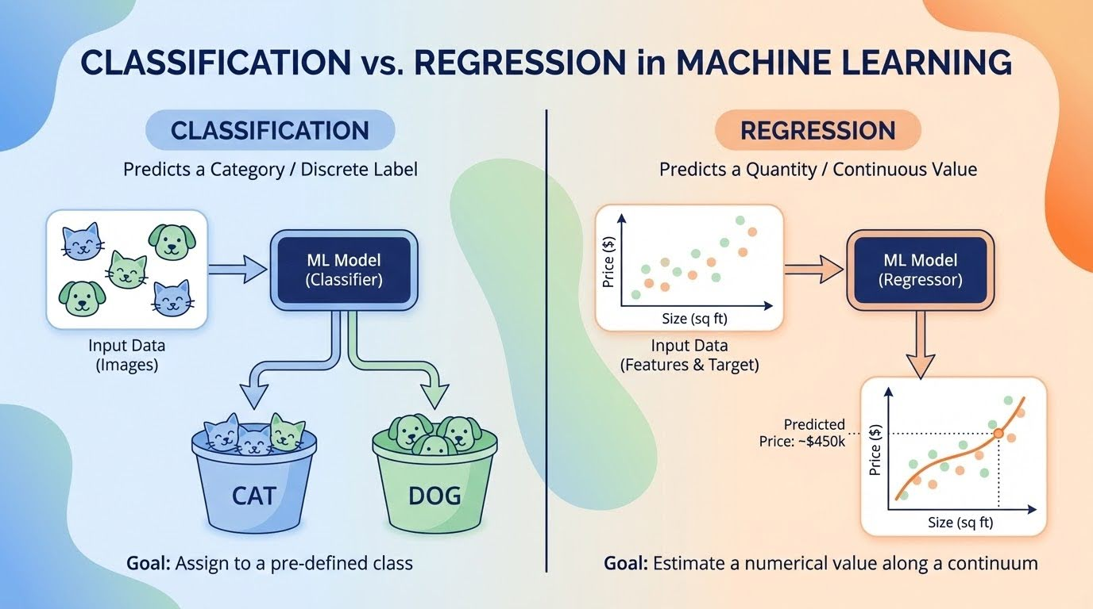
Major Categories
Classification:
Classification assigns input data into distinct, predefined classes or labels.
Regression:
Regression models the relationship between independent variables and a continuous numerical target to estimate quantities.

Slide 6
Real World Examples
Classification | Regression
Email SPAM Classification | Property Price Prediction
Fraud Detection | Salary Prediction
Image Classification | Stock Price Forecasting

Slide 7
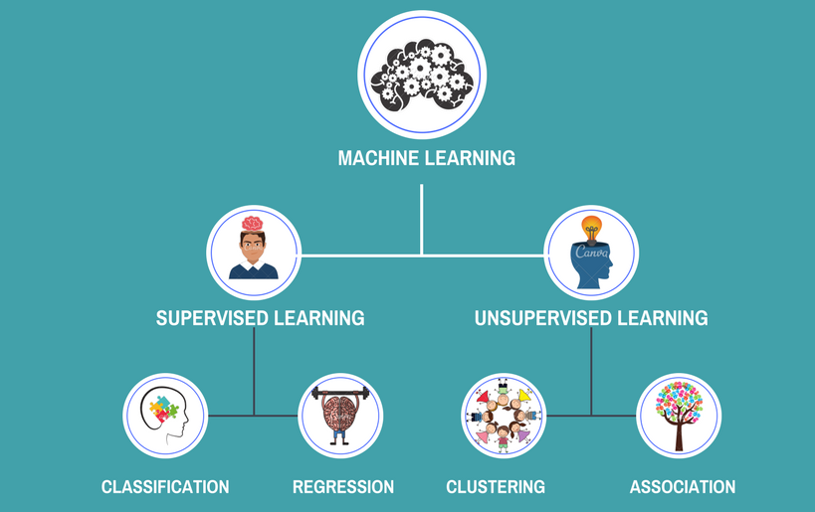
Supervised and Unsupervised Learning
Supervised learning acts like a student learning with a teacher guiding them through a labeled answer key, while unsupervised learning acts like an explorer finding hidden structures in data completely on its own.

Slide 8
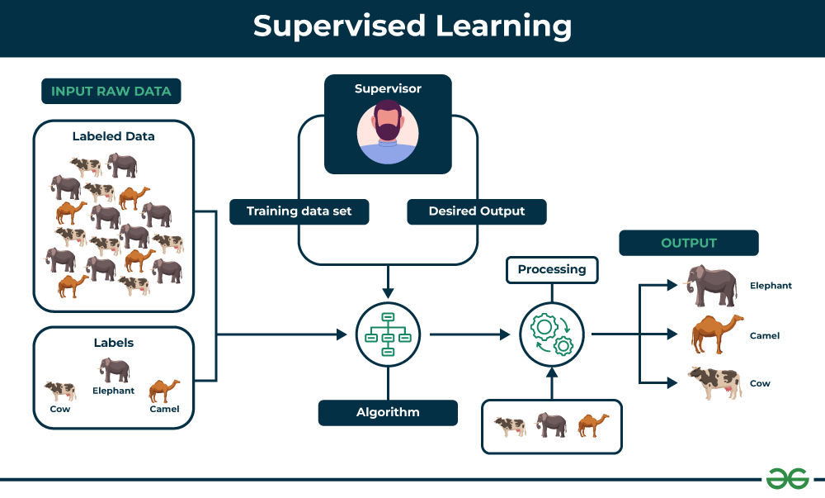

Slide 9
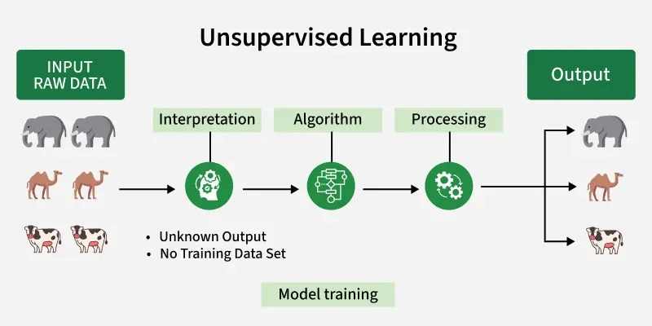

Slide 10
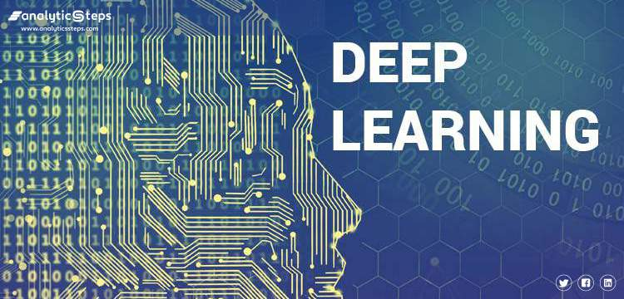
Deep Learning
Deep Learning is a machine learning technique that uses neural networks to learn from large amounts of data, mimicking the human brain’s ability to recognize patterns and make decisions.

Slide 11
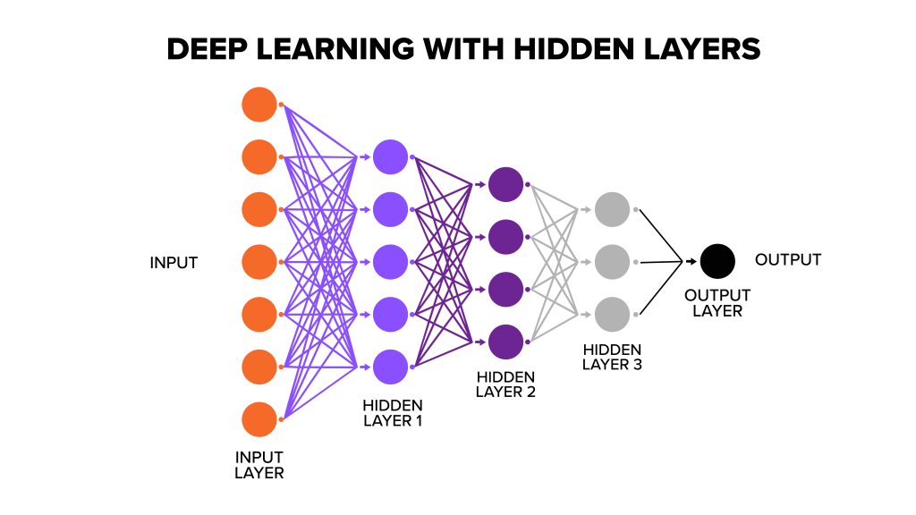
Neural Network
A neural network is a machine learning model inspired by the human brain, while deep learning is a subset of machine learning that uses multi-layered neural networks (typically with multiple hidden layers) to automatically learn complex features from data

Slide 12
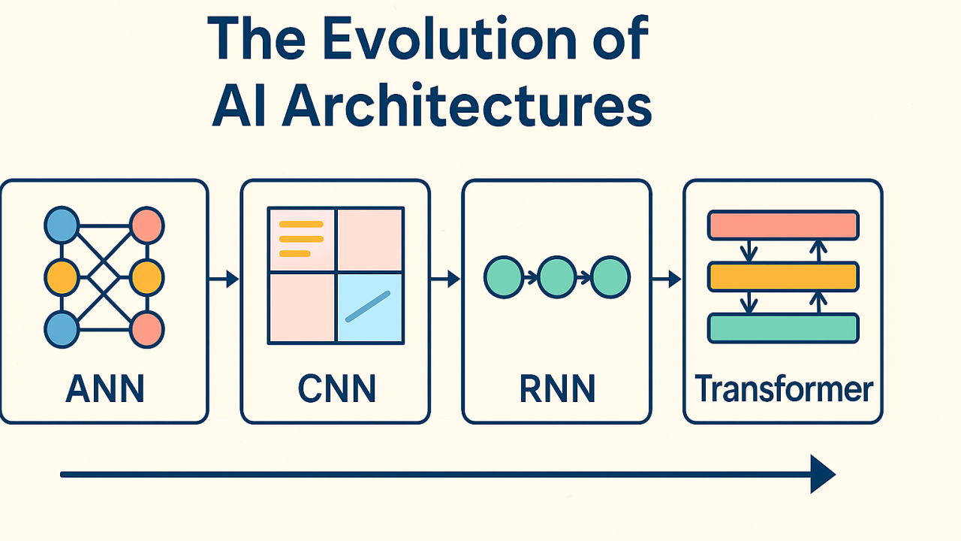

Slide 13
Thank You

